Slide 1
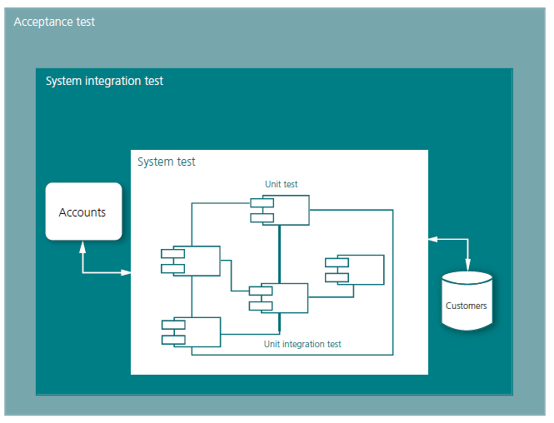
3 WHAT IS TESTING?.................................................................... 33
3.1 Controllability – How Do We Ask the Questions? .................. 34
3.2 Test Design – What Questions Do We Ask?............................. 34
3.3 Observability – How Do We See the Answers? ....................... 34
3.4 Oracle – How Do We Know if The Answers are Correct?....... 35
3.4.1 Heuristics ................................................................................... 35
3.4.2 High Volume Automated Testing ............................................ 35
3.5 Example: Loan Application ...................................................... 35
5 APPROACHES ............................................................................ 49
5.1 Test Levels.................................................................................. 49
5.1.1 Unit Testing ............................................................................... 49
5.1.2 Unit Integration Testing ........................................................... 50
5.1.3 System testing ........................................................................... 50
5.1.4 System Integration Testing....................................................... 50
5.1.5 Acceptance Testing ................................................................... 50
5.1.6 Test Levels in Production .......................................................... 51
5.2 Which Tests Do We Run? .......................................................... 52
5.3 Scripted Testing......................................................................... 53
5.4 The Context-Driven School....................................................... 54
5.5 Striking the Golden Balance .................................................... 55

Slide 2
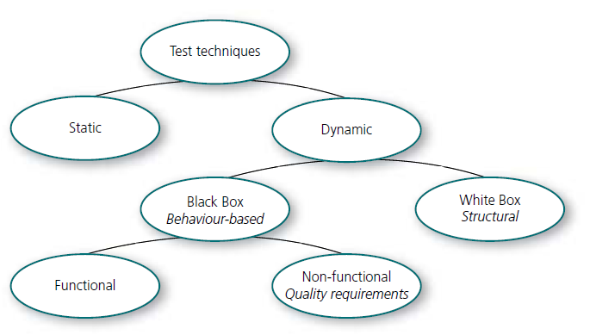
7 TEST DESIGN TECHNIQUES: AN OVERVIEW ............................ 77
7.1 Static and Dynamic Techniques................................................ 77
7.2 Static Techniques....................................................................... 77
7.2.1 Inspection .................................................................................. 78
7.2.2 Walkthrough............................................................................. 78
7.2.3 Technical Review....................................................................... 78
7.2.4 Informal Review........................................................................ 78
7.2.5 Modelling – an Alternative to Reviews ................................... 79
7.3 Dynamic Test Design Techniques ............................................. 79
7.3.1 Data ........................................................................................... 79
7.3.2 Flows.......................................................................................... 79
7.3.3 Logic: Sets of Rules, Formulae.................................................. 80
7.3.4 Combinatorial Analysis............................................................. 80
7.3.5 Experience based testing.......................................................... 80
7.3.6 Advanced Testing...................................................................... 80
7.4 Black, White and Grey .............................................................. 81
7.4.1 Black Box Techniques – Behaviour-Based Testing ................... 81
7.4.2 White Box Techniques – Structural Testing ............................. 81
7.4.3 Combined: Grey Box Testing .................................................... 81
7.5 Non-functional Tests ................................................................. 82
7.6 How Many Design Techniques are There? .............................. 83
7.7 The Selection in This Book ....................................................... 83
7.8 The ISTQB Standard .................................................................. 83
7.9 The Academic World................................................................. 84
7.10 Companies Which are Far Ahead in the Field of Testing ....... 85
7.11 Other Sources............................................................................ 89

Slide 3
3 WHAT IS TESTING?
Test의 정의: TESTING IS TO ask questions of a test object and compare the answers with some kind of expected result in order to decide whether a particular aspect of the test object works as intended.
3.1 Controllability – How Do We Ask the Questions?
시스템에 어떻게 접근하여 테스트하는가? 키보드, 마우스, 리모컨, API 등
3.2 Test Design – What Questions Do We Ask? => Test 항목
3.3 Observability – How Do We See the Answers? => Test 결과 확인 방법
3.4 Oracle – How Do We Know if The Answers are Correct? => Test 기대 결과
• Manually calculated
• Calculations in some type of tool: e.g. MS Excel™
• Earlier versions of the same product: in those cases we perform an update of existing code
• Other similar products that we estimate are correct: e.g. internal or external systems with the same data or functions
• Completed suites of tests which somebody else has built and tested. This is often used for testing compilers, web browsers and SQL-tools10
3.4.1 Heuristics
• Consistent with history and our image
• Consistent with similar products
• Consistent within product
• Consistent with user´s expectations
3.4.2 High Volume Automated Testing
• Unauthorised defect messages should not appear – e.g. search for the text Defect
• The system should not crash
• Features which lock up, where you stick in one place, should not be present
3.5 Example: Loan Application

Slide 4
5 APPROACHES
5.1 Test Levels
5.1.1 Unit Testing
5.1.2 Unit Integration Testing
5.1.3 System testing
5.1.4 System Integration Testing
5.1.5 Acceptance Testing
5.1.6 Test Levels in Production
Sometimes, you run something called a pilot for a limited number of end
users.
5.2 Which Tests Do We Run?
One suggestion for an approach is to start from what a test is worth in relation
to its cost, where this value is directly related to the risk.
5.3 Scripted Testing
This means that all requirements are clearly
stated before coding begins, and that the testers only begin when the coding is complete.
The obvious problems with scripted testing, when applied in reality, have led to great debate
in the testing world, between those who consider that all test cases, and their
expected results, can and must be documented in full before the tests are run,
and those who say that we can never know everything we need to know in advance.

Slide 5
5.4 The Context-Driven School
Rule:
1. The value of each practice depends on its context.
2. There is good practice in its own context, but there is no best practice which applies at all times.
3. People who work together are the most important part of how every project fits together.
4. The project is developed over time in a way which often cannot be predicted.
5. The product is a solution: if the problem is not solved, the product does not work.
6. Good software testing is a challenging intellectual process.
7. Simply through judgement and skill, put into practice together throughout
the whole project, we can do the right thing at the right time in order to test our products effectively.
-> Supporters of this school make regular use of exploratory testing.
5.5 Striking the Golden Balance
Most often, the tests consist of a mixture of scripted and exploratory
testing. Some parts are scripted and others are supplemented afterwards.

Slide 6
7 TEST DESIGN TECHNIQUES: AN OVERVIEW
7.1 Static and Dynamic Techniques
=> A static technique involves examining documentation, design or code, while a dynamic one involves studying the program while it is being run.
7.2 Static Techniques
7.2.1 Inspection - The most formal review technique
7.2.2 Walkthrough - less formal techniques, The purpose is more one of creating a common picture, than of identifying defects
7.2.3 Technical Review - technical review focuses on architecture and program design to evaluate choices of solution, and compliance with standards
7.2.4 Informal Review
7.2.5 Modelling – an Alternative to Reviews
7.3 Dynamic Test Design Techniques : Dynamic testing involves testing code by executing it
7.3.1 Data
7.3.2 Flows
7.3.3 Logic: Sets of Rules, Formulae
7.3.4 Combinatorial Analysis
7.3.5 Experience based testing : risk lists, defect guessing, taxonomies, defect classifications and attack patterns + Error guessing
7.3.6 Advanced Testing
7.4 Black, White and Grey
7.4.1 Black Box Techniques – Behaviour-Based Testing -> input or output data-driven testing
This is aimed at verifying whether a system behaves correctly from the outside, without us being concerned about what is happening inside
– hence the commonly used expression black box testing.
7.4.2 White Box Techniques – Structural Testing -> tests is to verify the internal logic in the test object
used at the component testing and program integration testing stages and requires detailed knowledge of how the system is built.
The structural tests encompass control flow (program flow) and data flow.
Control flow tests check that the internal program logic is working.
Data flow tests verify whether the way a variable is defined, used and destroyed is handled correctly.
important to test all boundary values and error conditions carefully.
7.4.3 Combined: Grey Box Testing

Slide 7
7.5 Non-functional Tests
1 Functionality: Are the desired functions present? suitability, correctness, compatibility, compliance with standards, security
2 Reliability: Is the system robust, and does it work in different situations? maturity, defect tolerance, restart (after defect), accessibility
3 Usability: Is the system intuitive, comprehensible and simple to use? intelligibility, learning requirements, ownership
4 Efficiency: Does the system use resources well? time aspects (e.g. performance characteristics), resource requirements (e.g. scalability)
5 Maintainability: Can the workforce, developers and users upgrade the system when needed? analysability, modifi ability, confi gurability, testability
6 Portability: Can the system work on different platforms, with different databases, etc.? adaptability, installation requirements, compliance with
standards, replaceability
7.6 How Many Design Techniques are There?
7.7 The Selection in This Book
7.8 The ISTQB Standard
7.9 The Academic World
7.10 Companies Which are Far Ahead in the Field of Testing
7.11 Other Sources

